Slide 1



Churn and Customer Risk Analysis
View in Power BI
Last data refresh:
3/16/2024 9:03:11 PM UTC
Downloaded at:
3/16/2024 9:25:42 PM UTC

Slide 2
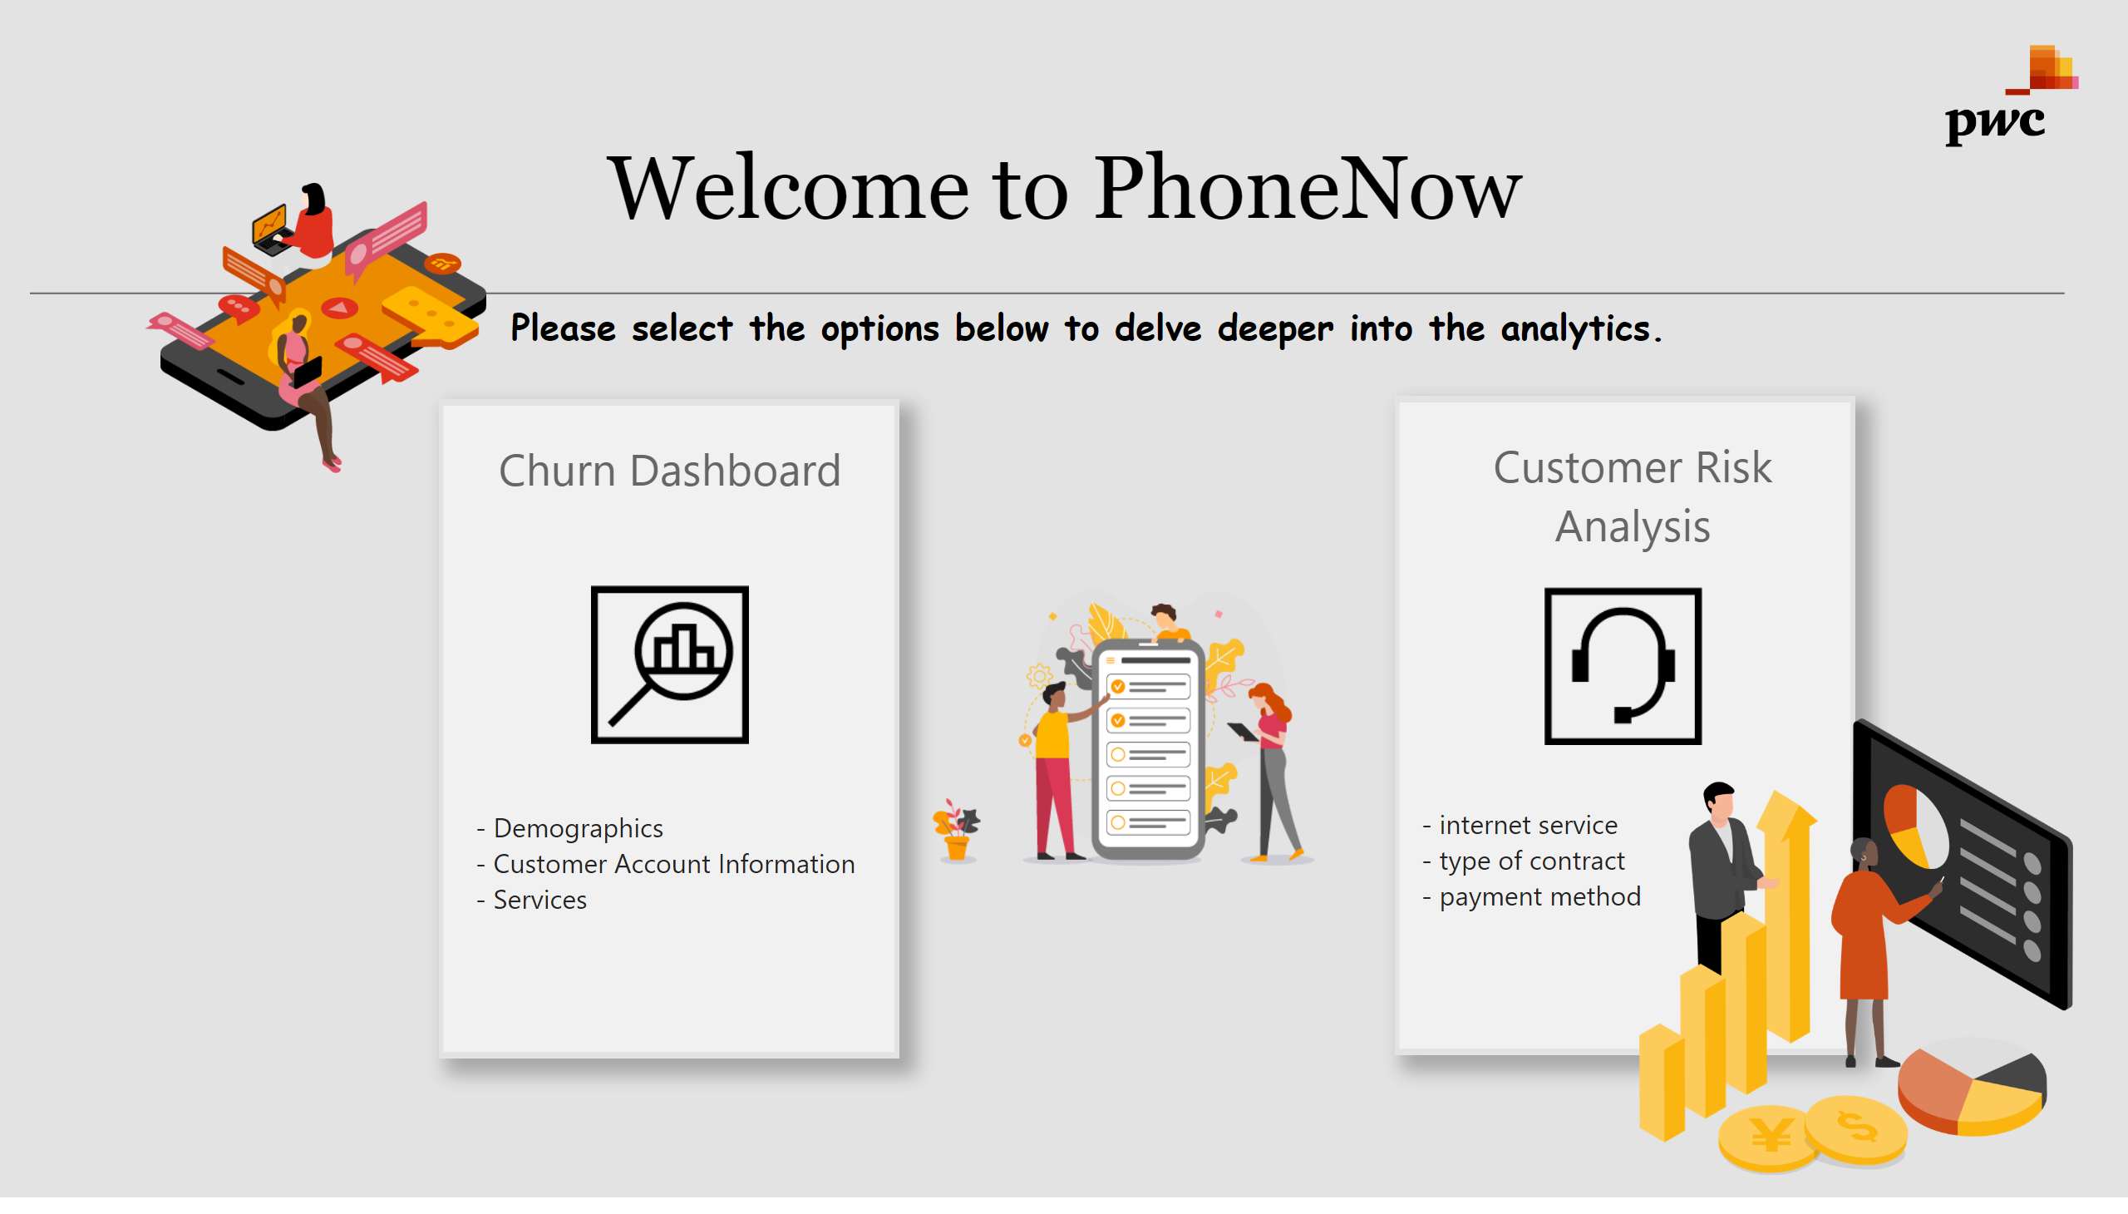
Home
Notes:
textbox
No alt text provided
basicShape
No alt text provided
image
No alt text provided
image
No alt text provided
textbox
No alt text provided
image
No alt text provided
textbox
No alt text provided
textbox
No alt text provided
basicShape
No alt text provided
image
No alt text provided
textbox
No alt text provided
textbox
No alt text provided
basicShape
No alt text provided
image
No alt text provided
image
No alt text provided

Slide 3
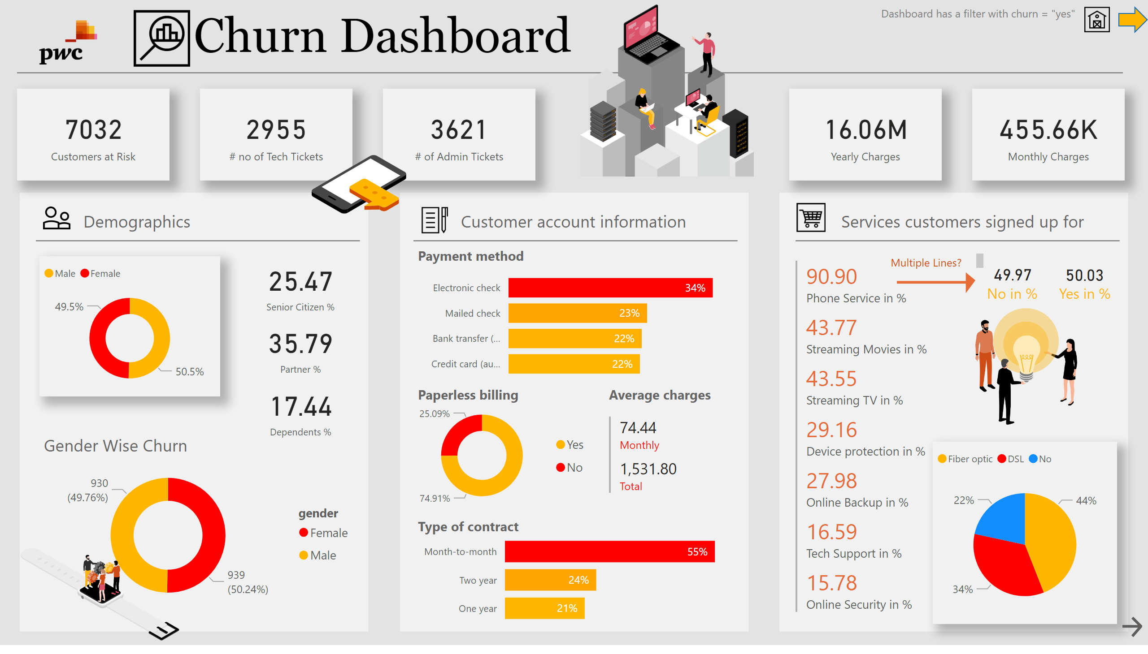
Churn Report
Notes:
textbox
No alt text provided
basicShape
No alt text provided
basicShape
No alt text provided
card
No alt text provided
basicShape
No alt text provided
basicShape
No alt text provided
textbox
No alt text provided
basicShape
No alt text provided
image
No alt text provided
textbox
No alt text provided
basicShape
No alt text provided
textbox
No alt text provided
basicShape
No alt text provided
image
No alt text provided
image
No alt text provided
donutChart
No alt text provided
card
No alt text provided
card
No alt text provided
card
No alt text provided
clusteredBarChart
No alt text provided
clusteredBarChart
No alt text provided
textbox
No alt text provided
textbox
No alt text provided
donutChart
No alt text provided
multiRowCard
No alt text provided
textbox
No alt text provided
pieChart
No alt text provided
card
No alt text provided
card
No alt text provided
textbox
No alt text provided
textbox
No alt text provided
textbox
No alt text provided
textbox
No alt text provided
multiRowCard
No alt text provided
basicShape
No alt text provided
basicShape
No alt text provided
donutChart
No alt text provided
textbox
No alt text provided
image
No alt text provided
actionButton
No alt text provided
image
No alt text provided
card
No alt text provided
image
No alt text provided
image
No alt text provided
card
No alt text provided
card
No alt text provided
card
No alt text provided
textbox
No alt text provided
image
No alt text provided
image
No alt text provided
image
No alt text provided
shape
No alt text provided

Slide 4
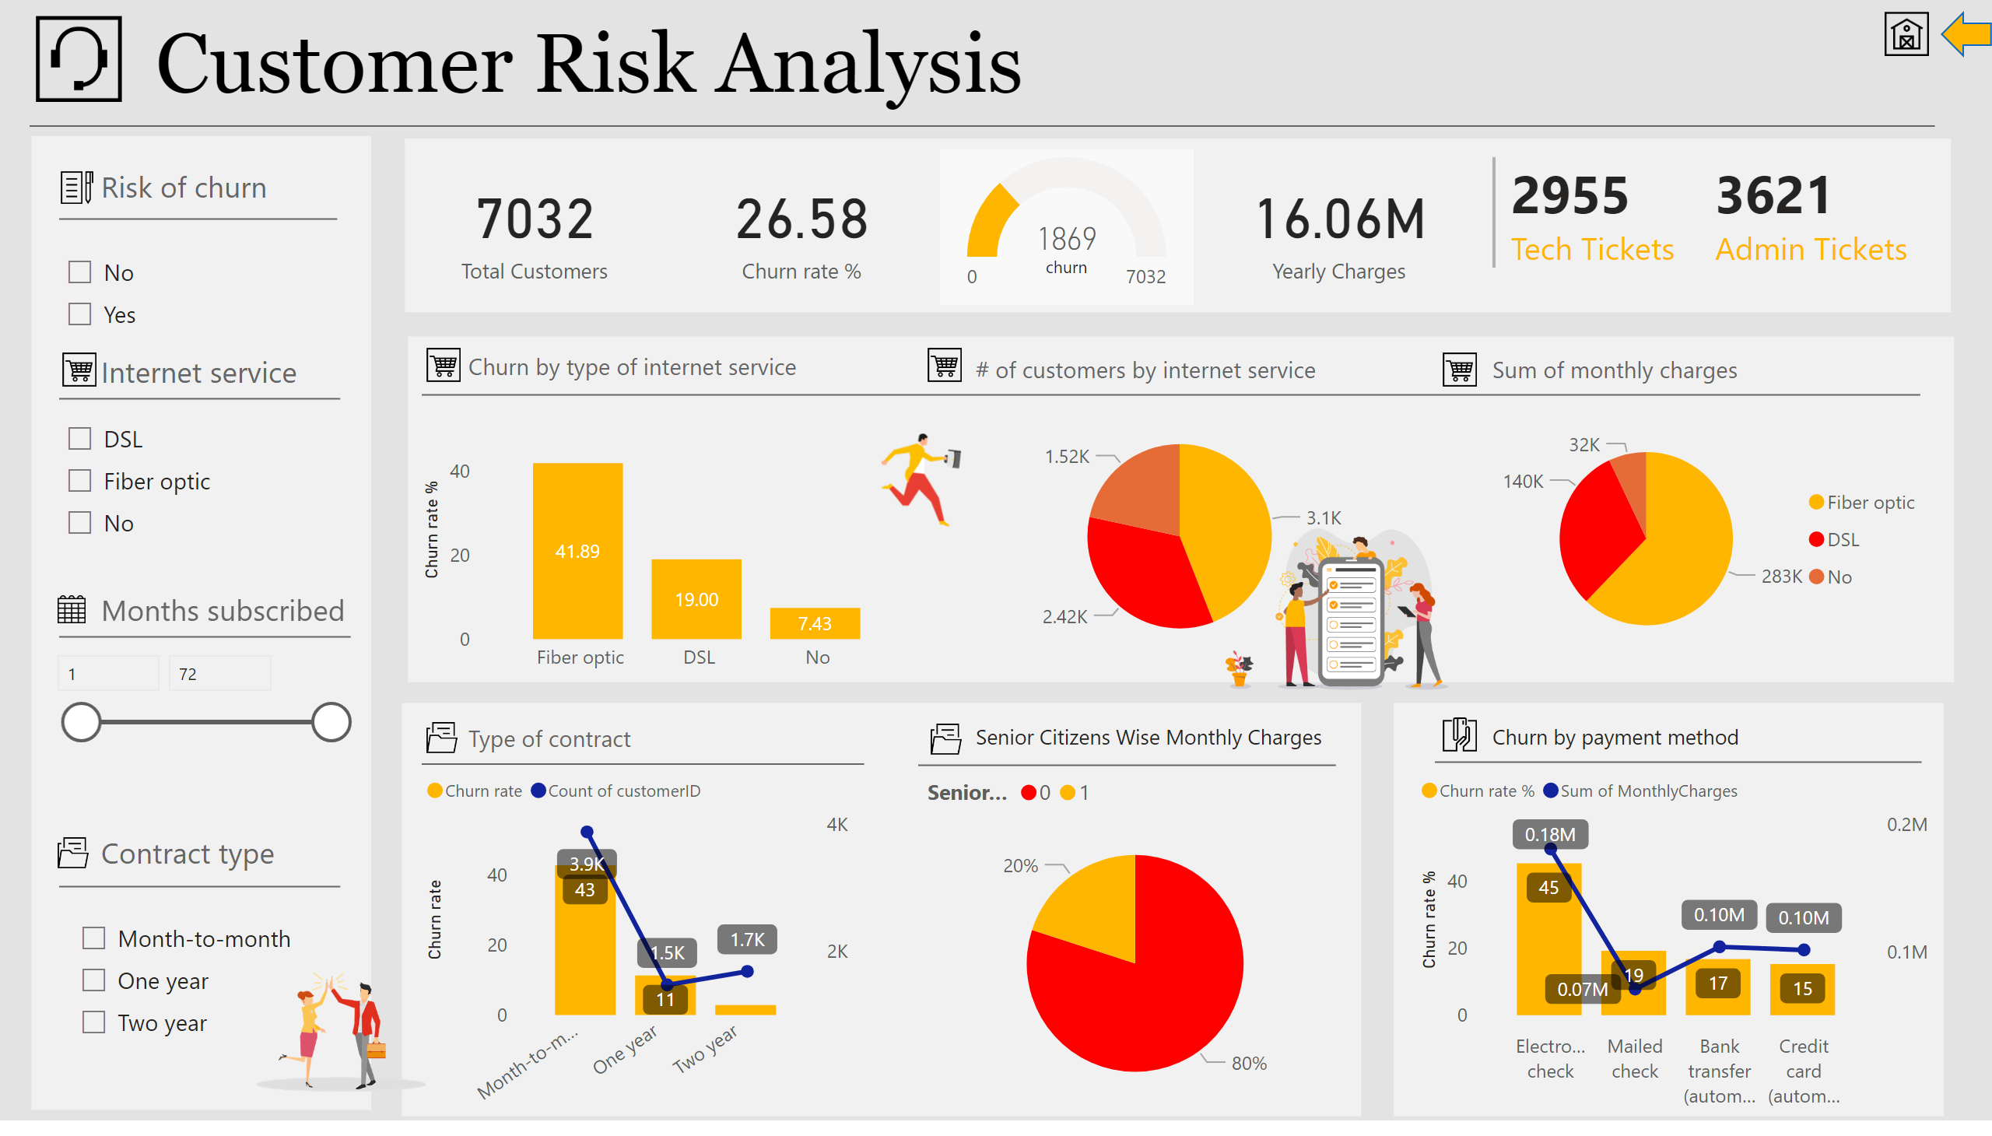
Cus Risk Analysis
Notes:
textbox
No alt text provided
basicShape
No alt text provided
basicShape
No alt text provided
basicShape
No alt text provided
card
No alt text provided
gauge
No alt text provided
slicer
No alt text provided
card
No alt text provided
slicer
No alt text provided
image
No alt text provided
image
No alt text provided
Number of months subscribed
No alt text provided
image
No alt text provided
textbox
No alt text provided
basicShape
No alt text provided
textbox
No alt text provided
basicShape
No alt text provided
basicShape
No alt text provided
image
No alt text provided
textbox
No alt text provided
image
No alt text provided
image
No alt text provided
textbox
No alt text provided
basicShape
No alt text provided
slicer
No alt text provided
card
No alt text provided
lineClusteredColumnComboChart
No alt text provided
pieChart
No alt text provided
textbox
No alt text provided
basicShape
No alt text provided
clusteredColumnChart
No alt text provided
pieChart
No alt text provided
pieChart
No alt text provided
textbox
No alt text provided
textbox
No alt text provided
basicShape
No alt text provided
basicShape
No alt text provided
textbox
No alt text provided
textbox
No alt text provided
basicShape
No alt text provided
basicShape
No alt text provided
lineClusteredColumnComboChart
No alt text provided
basicShape
No alt text provided
textbox
No alt text provided
multiRowCard
No alt text provided
basicShape
No alt text provided
image
No alt text provided
image
No alt text provided
image
No alt text provided
image
No alt text provided
image
No alt text provided
image
No alt text provided
image
No alt text provided
textbox
No alt text provided
image
No alt text provided
image
No alt text provided
shape
No alt text provided

